Slide 1
Prudential life insurance risk model
A Kaggle competition for GA – PT Data Science ’15-’16
Patrick Kennedy – 2.15.16
patrick@structuredmotivation.com

Slide 2
What is the problem?
Prudential life insurance
30 day process to establish risk
What if we could …
make life insurance selection on-demand?
Let’s build a model to predict levels of risk as measured by application status

Slide 3
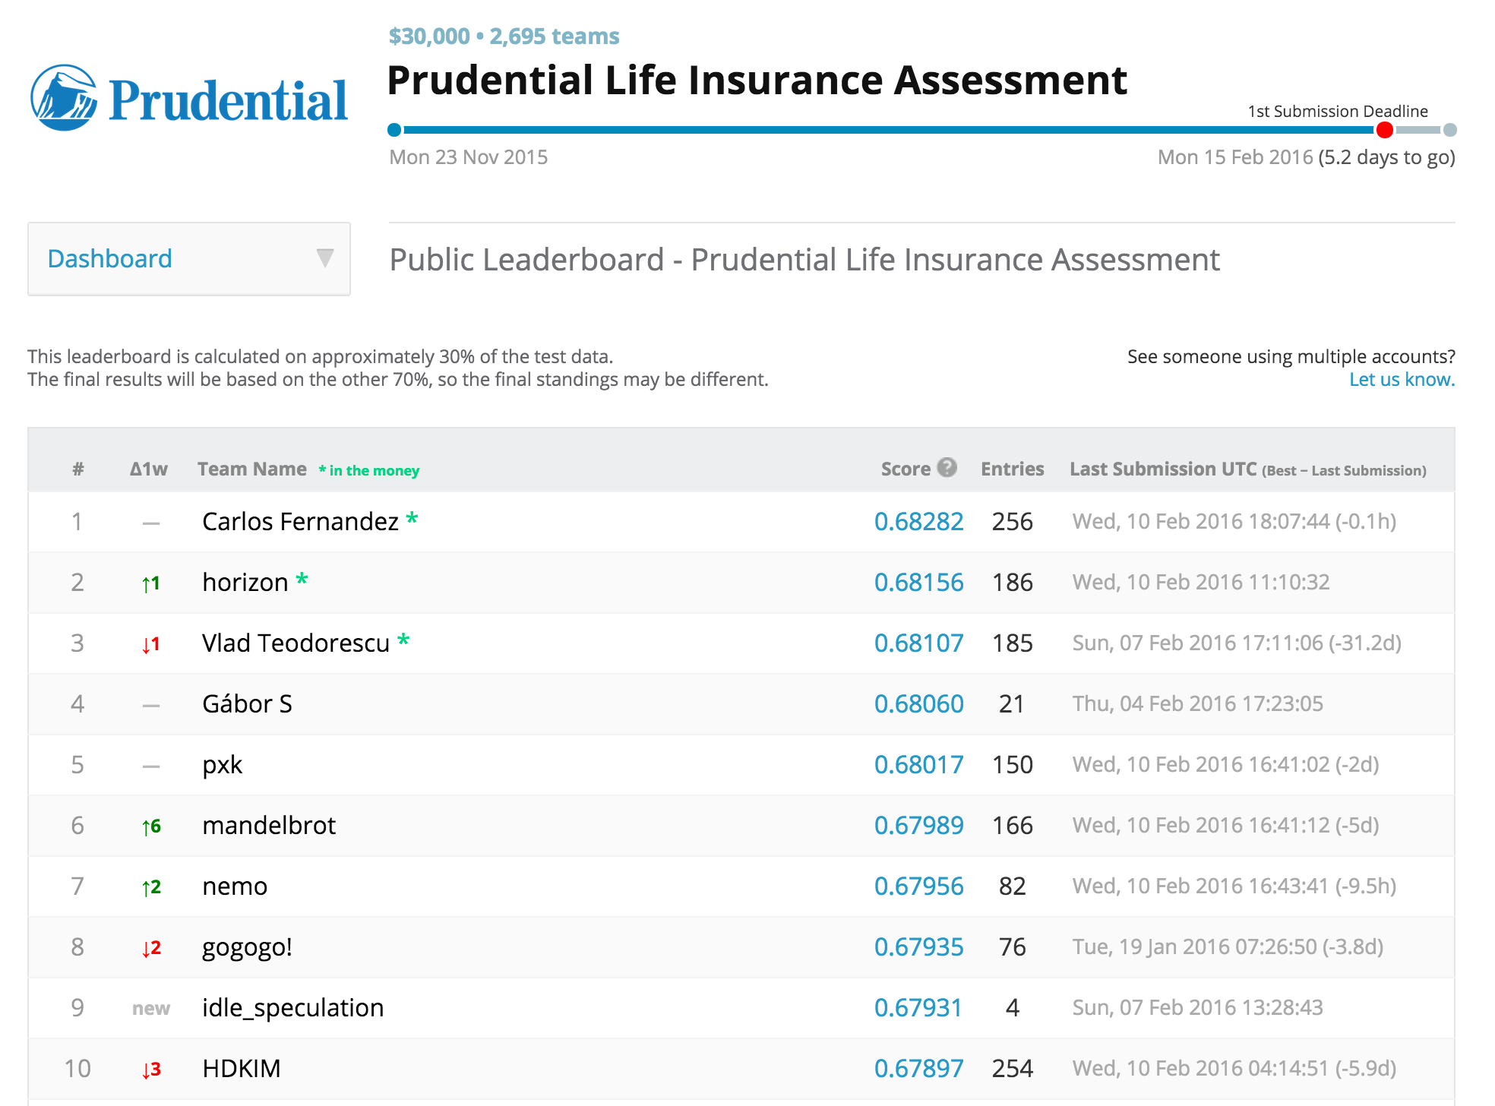
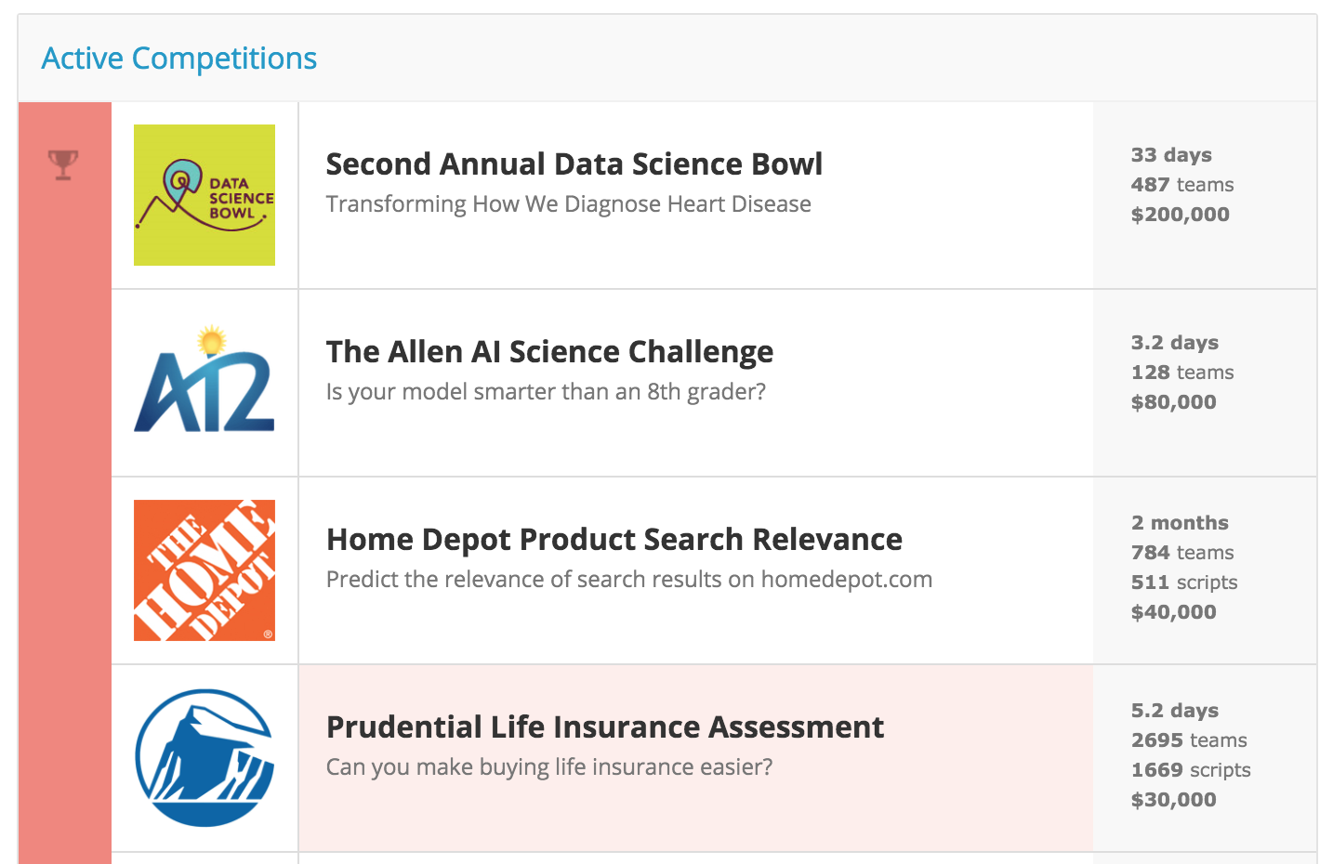
Leaderboard
Show kaggle leaderboard with scores (as measured by QWK)
Goal? 30k

Slide 4
The Data
Anonymized:
Train [59381, 128], Test[19765, 127]
13 continuous
65 categorical
4 discrete
48 other
1 Id, 1 Response
Contains no apriori intuition
The real trick is that there are 8 classes of output… I choose to build models based on a
continuous target and then use a function to provide cut points before submitting final predictions
(…it seemed a little easier than building 8 separate models)
Notes:
Multilabel output is tough with 8 categories so regression approach is applied… creating a problem over how to optimize the cut points for the predicted data set

Slide 5
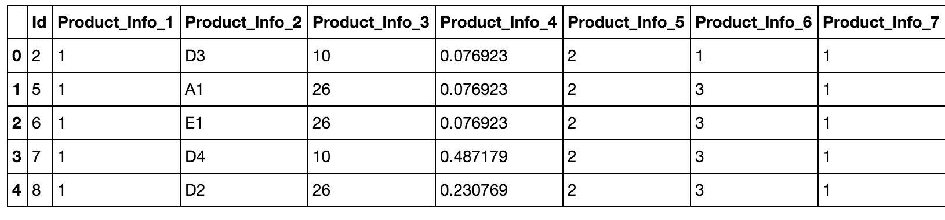
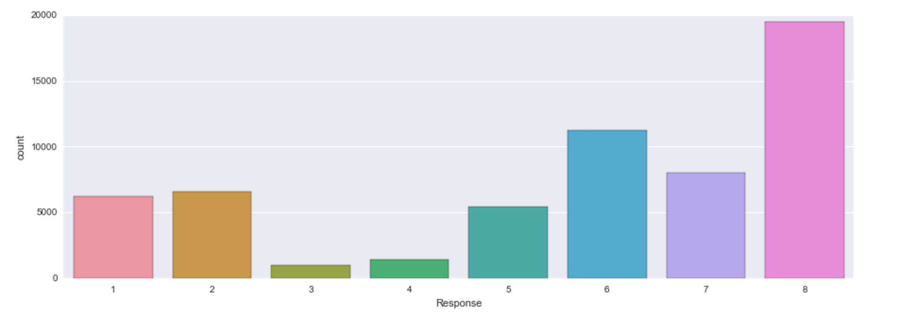
Initial Exploration
…
Notes:
Potential trouble in classifying 3 and 4 but still have fairly high counts of each…. Multiclass classification? Regression with optimized cut points?
Some vars have loads of NaNs but unclear if those have an effect on the results or not given such few data points in those bins.... Taking them out of the baseline model did not alter the results so they are left in

Slide 6

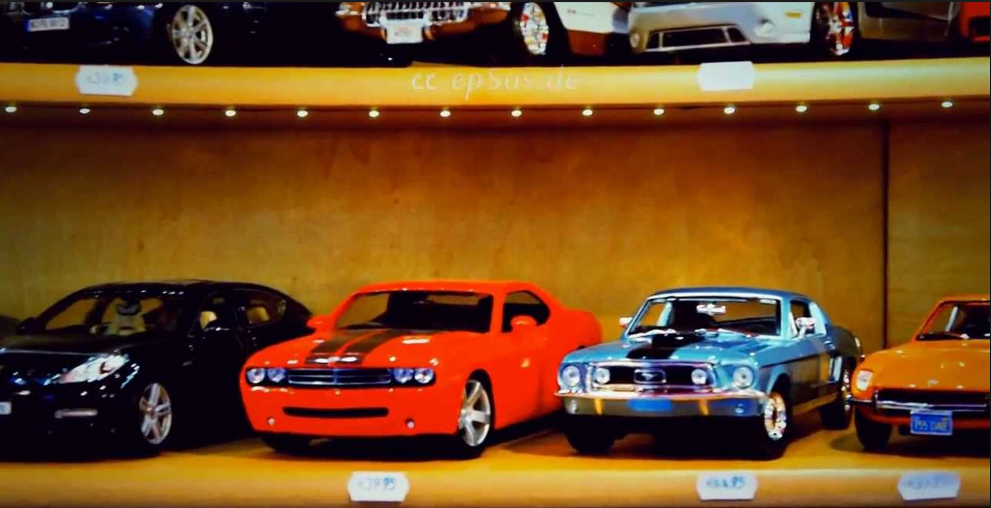

Roadmap
1. Find a model
4. Results?
2. Build a network of models
3. Tune
Notes:
Animate this

Slide 7
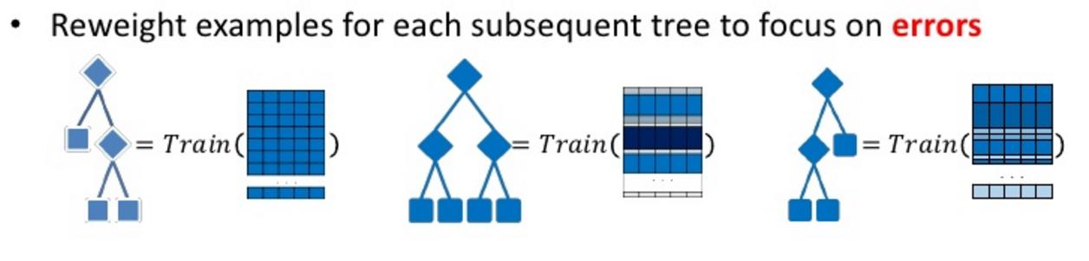
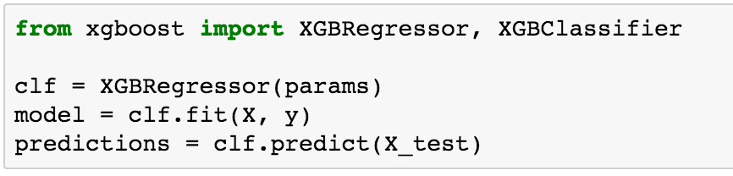
Baseline model (1/2)
Rank: 138 / 1970
Top 10%**
XGBoost – Score of .669
XGBoost stands for eXtreme Gradient Boosting
Parallelized tree boosting / FAST
Has python wrappers for ease of use
Notes:
Can learn more about xgboost on their github page and by playing around with it

Slide 8
Baseline model (2/2)
Process:
1) train model
2) train offsets
3) apply offsets to predicted test set
fmin_powell, quadratic weighted kappa
fmin_powell is an optimization method – sequentially minimizing each vector passed and updating iteratively
QWK is inter-rater agreement measure. Except it takes into account how wrong measures are and penalizes greater disagreement

Slide 9
Actual
Predicted
New Predictions
8
6
7
3
6
5
5
4
1
2
4
2
8
3
7.35
6.72
7.11
1.32
5.49
5.12
5.03
3.19
1.01
2.47
4.11
2.54
8.32
3.00
12.48
5.99
11.22
2.56
5.56
5.11
5.03
3.78
0.03
2.48
3.76
1.98
23.09
3.24
Offset Guesses
(applied per class)
optimize
sequentially
round
-QWK
np.clip(data, 1, 8)
1.
2.
3.
4.
5.
6.
7.

Slide 10
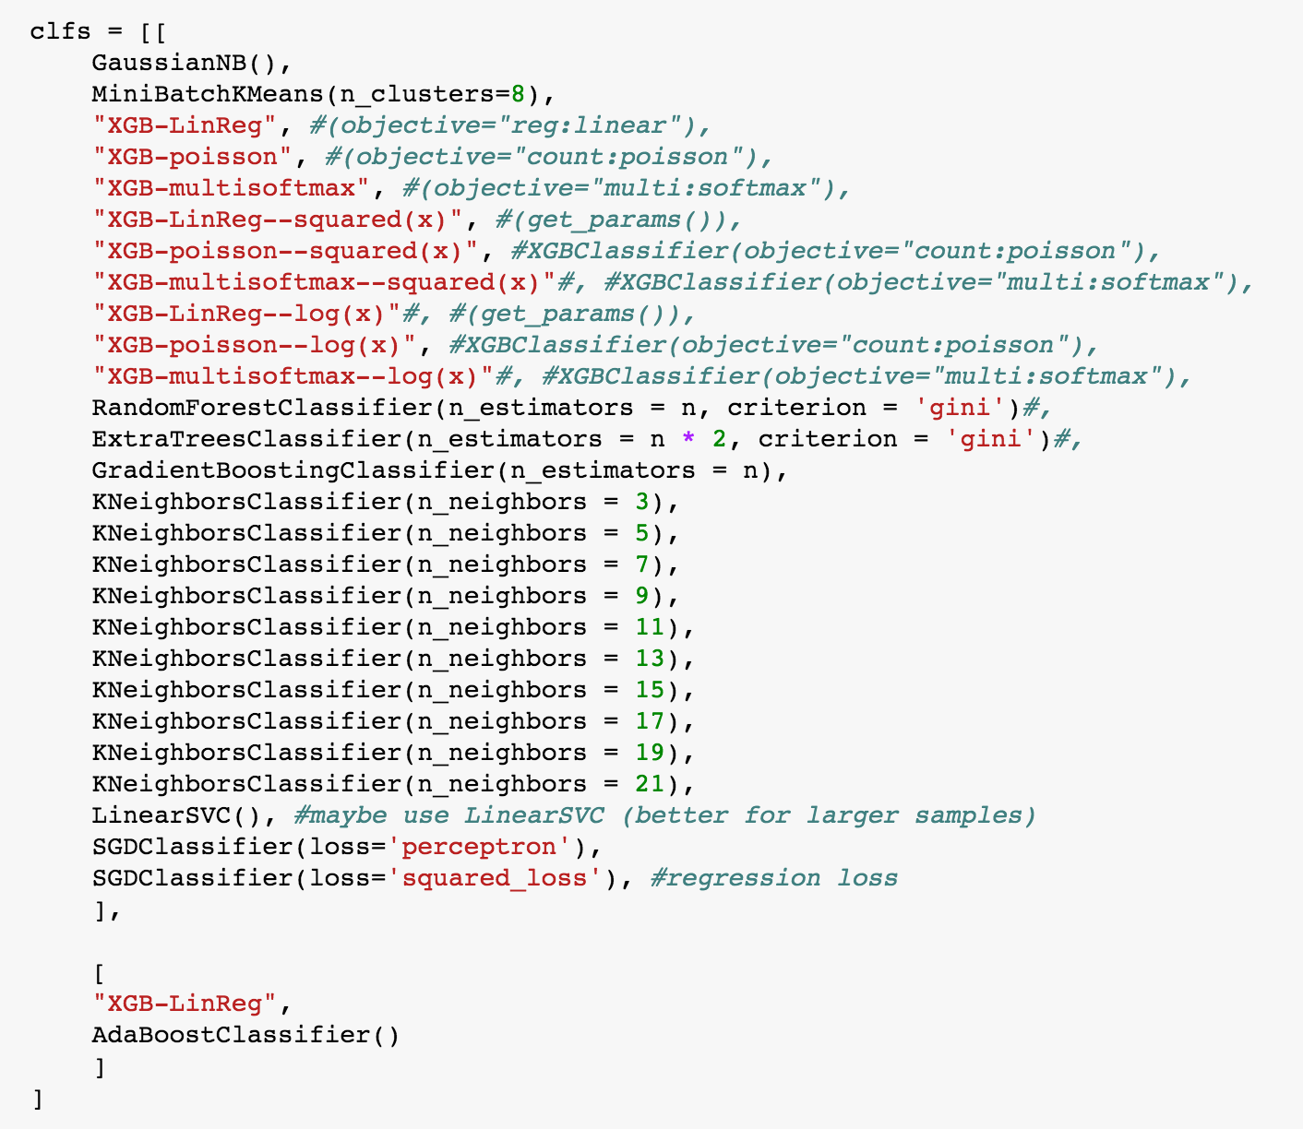
MOAR models
When one is good, how about 29?
Notes:
Have reasons for these models

Slide 11
Level 1
Level 2
Level 3
Level 4
Model 1
Model 2
Model 3
Model 4
…
Model 27
XGBoost
Weighted
Predictions
Train / Apply offset
AdaBoost
Stacking: [...] stacked generalization is a means of non-linearly combining generalizers to make a new generalizer,
to try to optimally integrate what each of the original generalizers has to say about the learning set.
The more each generalizer has to say (which isn’t duplicated in what the other generalizer’s have to say),
the better the resultant stacked generalization. Wolpert (1992) Stacked Generalization
Blending: A word introduced by the Netflix winners. It is very close to stacked generalization,
but a bit simpler and less risk of an information leak. Some researchers use “stacked ensembling”
and “blending” interchangeably. With blending, instead of creating out-of-fold predictions for
the train set, you create a small holdout set of say 10% of the train set. The stacker model then
trains on this holdout set only. (http://mlwave.com/kaggle-ensembling-guide/)

Slide 12
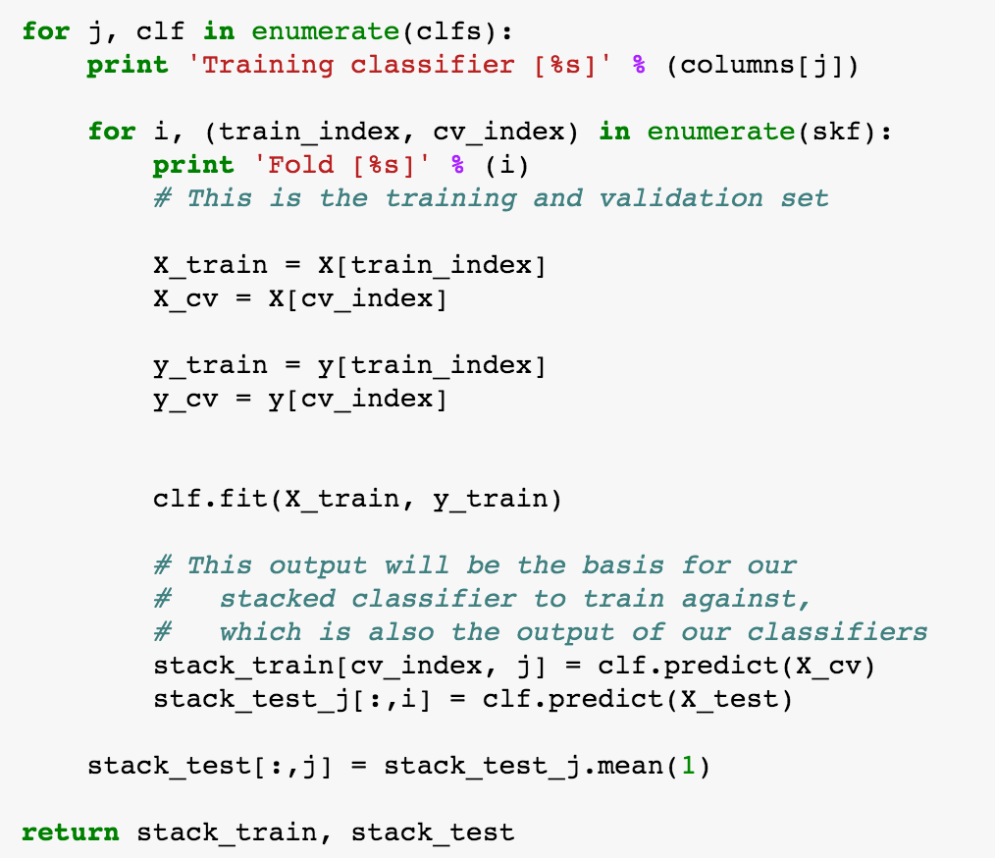
do this for each classifier…
TRAIN
1. Train Model
CV
2. Predict CV
TEST
3. Predict Test
4. CV predictions become new train set
Avg. test predictions become new test set
5. Iterate
Or you can use [stacked_generalization] @ https://github.com/dustinstansbury/stacked_generalization
and do this automatically – and a lot faster!
Notes:
Trouble in computation time… high time cost (>24 hours to run)... Get about the same result as i did with the single model (~0.665)
Interested in testing a model selection method by which individual models are tested against one another and highly uncorrelated models and models that give high scores are included... Models themselves are selected at random from a bucket of models... Haven’t gotten there yet and there is a reason... But we’ll get to that in a second

Slide 13
Stay tuned
Grid search, Random search
hyperopt & BayesOpt
(others: MOE, spearmint require mongodb instance)
Note: hyperopt also has the ability to select preprocessing and classifiers too … pretty cool
Method | Score | Time
GridSearchCV | n/a | Too long
RandomizedSearchCV | 0.473 | 24.4 hours
Hyperopt | 0.613 | 13 hours
BayesOpt | 0.663 | 62 minutes
scores for single XGBRegressor model
Notes:
Back to tuning a single XGBoost model to see how far off we were to begin with and then include the updated parameters back into the model (after all, I do want to win this competition and I can’t keep waiting a full day to see if my model building succeeded or not ;-)
Offset also adds about 0.03 to the score, so let’s keep that in there! ☺

Slide 14
Back to my models…
Trying new params with network of models (but fewer of them)… using ensemble based on optimizations
What are the results? (score and time)
What is the level system like?
WAIT A MINUTE!
Level 1
Level 2
Level 3
Level 4
Model 1
Model 2
Model 3
Model 4
…
Model 27
XGBoost
Weighted
Predictions
Train / Apply offset
AdaBoost
Notes:
Ok we tuned a handful of models… let’s put them in the ensemble and see what comes out the other end... Any better? Yes? No? Why? Is there a better more automated way to do this?

Slide 15
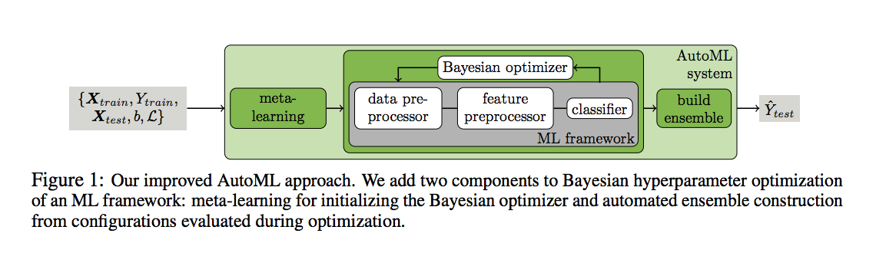
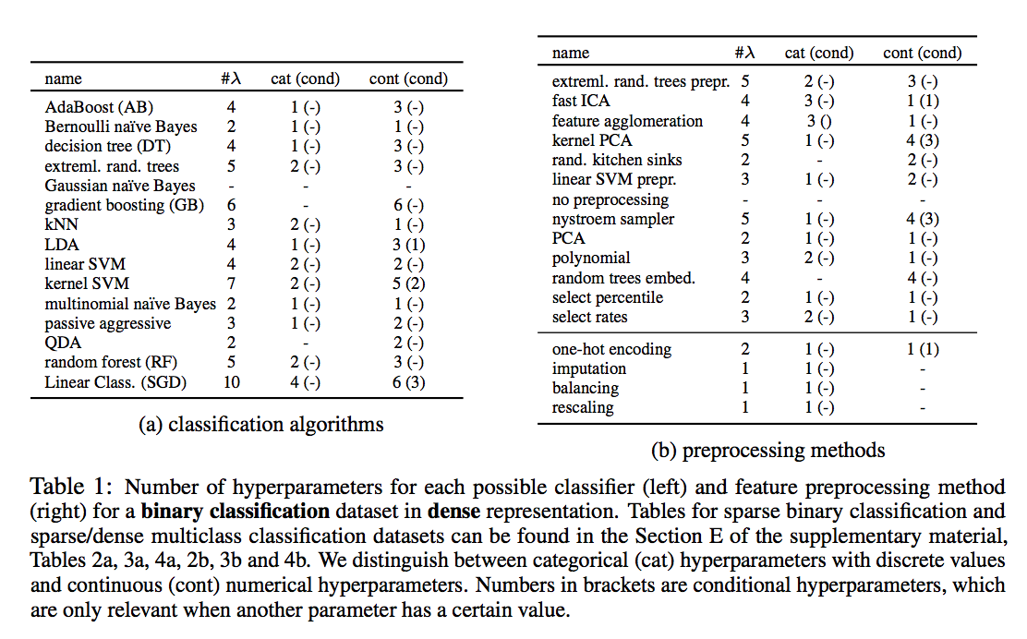
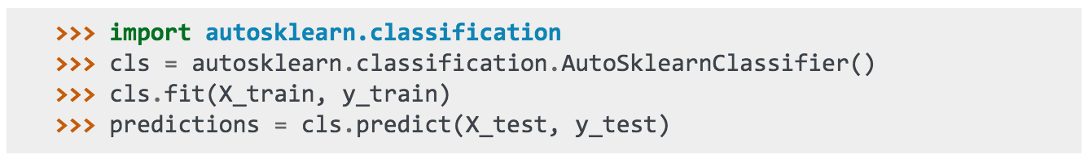
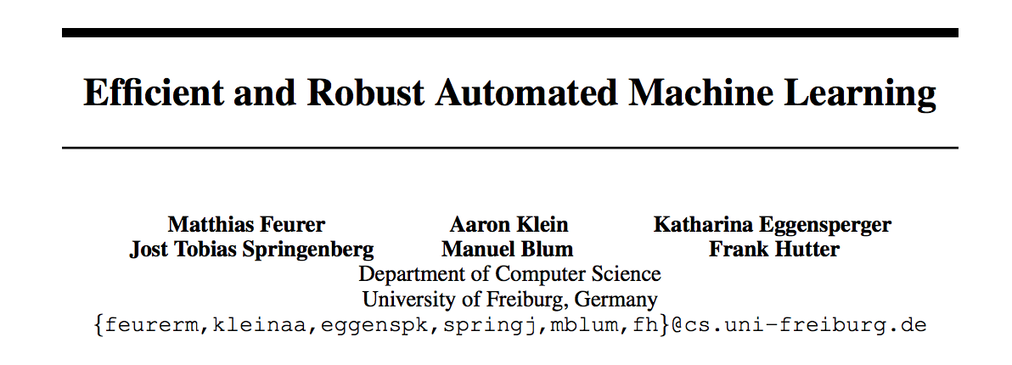
Auto-sklearn
Eh?
Notes:
Ah yes! There is a way to run all those models in one classifier (only runs on linux) … With enough models, no need to tune – but how many models are necessary?

Slide 16
Final-ish Results
Model | Best Score | Time
Single XGBoost | 0.669* | 15 minutes
4 level stack | 0.665 | ~12 hours
Tuned single XGBoost | 0.663 | 75 minutes
Auto-sklearn + XGBoost | 0.667 | 60 minutes
In the mean time my position has gone from 138/1970 to 660/2695 ~ 24th percentile
* Lucky seed
Notes:
Where I am now…

Slide 17
Last ditch effort
If model optimization is a dead-end, what other aspects can be optimized?
Offsets!
1a) Initial offset guesses (fmin is sensitive to these)
1b) Order in which the offsets are applied (fmin sensitive)
2) Binning predictions instead of applying offsets?
Are there really no intuitions about the data?
Notes:
Manual optimizations of order, initial guesses, binning

Slide 18
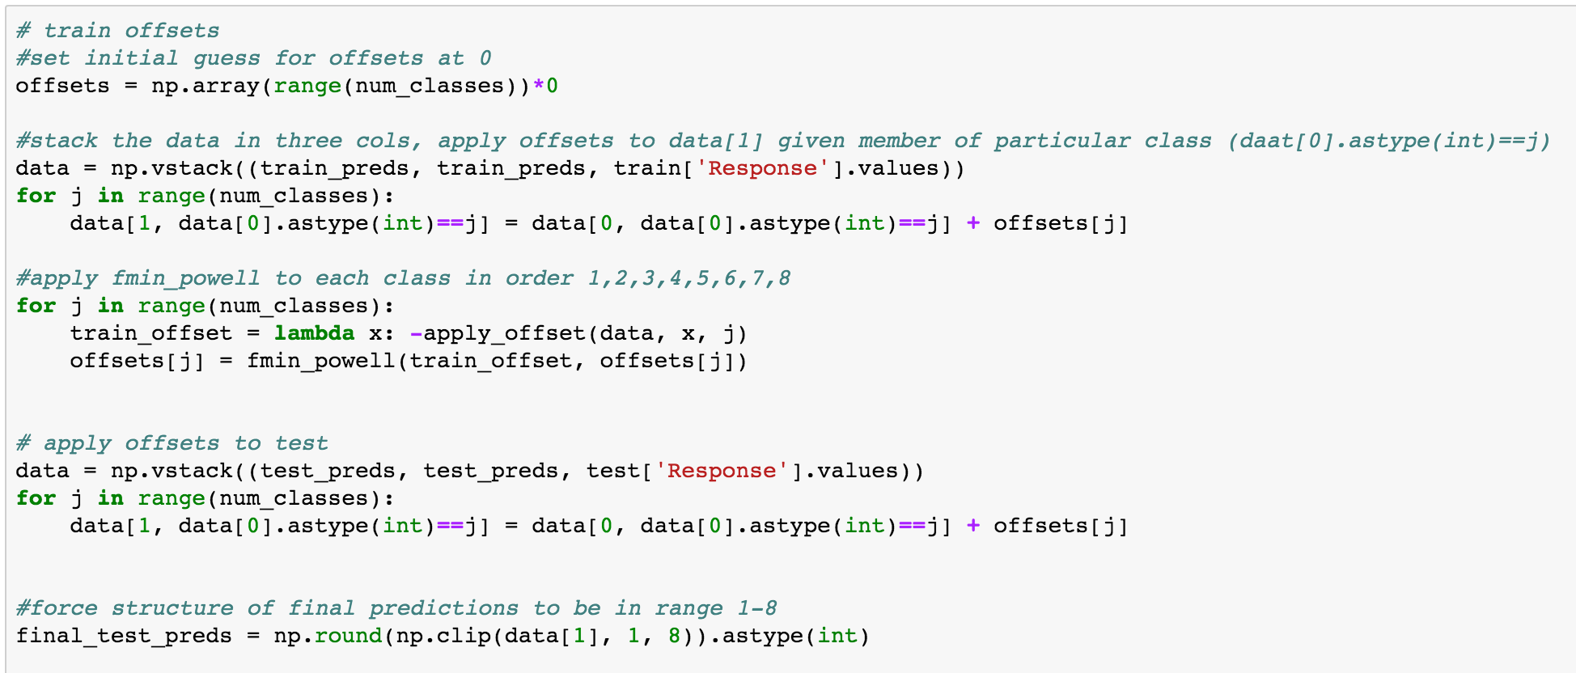

Slide 19
Final Results
Model | Best Score | Time
Single XGBoost | 0.669 | 15 minutes
4 level stack | 0.665 | ~12 hours
Tuned single XGBoost | 0.663 | 75 minutes
Auto-sklearn + XGBoost | 0.667 | 60 minutes
Optimize XGBoost offsets | 0.667 | 15 minutes + ~12hrs for optimizations
Optimize XGBoost bins | 0.664 | 15 minutes + ~4 hrs for optimizations
Notes:
Where I am now…

Slide 20
Roadmap
1. Find a model
4. Results?
2. Build a network of models
3. Tune
Notes:
Animate this

Slide 21
Next steps…
5 days left to....
Explore potential structural intuitions
(Count / Sum / Interactive effects)
Explore additional models like Neural Networks...
Down the road...
Beef up skills stacking and blending (optimize time) -or- Build my own
Win a GD competition
A note about insurance and risk...
Notes:
The note on insurance and risk… if it can be predicted with great accuracy, what happens when that information can be given to the individual rather than being held by insurance provider? More tuned need for insurance rather than blanket needs? Cost savings?
Employ neural networks? / post results?

Slide 22
Prudential life insurance risk model
A Kaggle competition for GA – PT Data Science ’15-’16
Patrick Kennedy – 2.15.16
patrick@structuredmotivation.com

